Slide 1


MIT School of Computing Department of Computer Science & Engineering
Third Year Engineering
21BTCS502-Database Management System
Class - T.Y. (Division-)
PLD
AY 2024-2025
SEM-I

Slide 2
Unit – II
Database Design

Slide 3
MIT School of Computing Department of Computer Science & Engineering
Syllabus
Functional Dependency, Purpose of Normalization, Data Redundancy and Update Anomalies, Functional Dependency Single Valued Dependencies.
Single Valued Normalization: 1NF, 2NF, 3NF, BCNF.
Decomposition: lossless join decomposition and dependency preservation.
Multi valued Normalization (4NF), Join Dependencies and the Fifth Normal Form.
PLD

Slide 4
Functional Dependency
Functional dependency in DBMS refers to the relationship between attributes within a table where one attribute's value uniquely determines another's.
Key points include:
Functional Dependency (FD) defines how one attribute relates to another within a database.
It ensures data integrity by linking attributes in a structured manner.
Denoted by an arrow (→), e.g., X→YX \rightarrow YX→Y, where XXX determines YYY.
XXX is the determinant attribute, and YYY is the dependent attribute.
Example: sid→snamesid \rightarrow snamesid→sname means the student ID sid uniquely determines the student's name sname.

Slide 5
Types of Functional Dependency
1.Multivalued dependency
2.Trivial functional dependency
3.Non-trivial functional dependency
4.Transitive dependency
1. Multivalued dependency-Multivalued dependency occurs in the situation where there are multiple independent multivalued attributes in a single table.
2. Trivial functional dependency -The Trivial dependency is a set of attributes which are called a trivial if the set of attributes are included in that attribute.
So, X -> Y is a trivial functional dependency if Y is a subset of X.

Slide 6
3. Non-trivial functional dependency-
Functional dependency which also known as a nontrivial dependency occurs when A->B holds true where B is not a subset of A. In a relationship, if attribute B is not a subset of attribute A, then it is considered as a non-trivial dependency.
4. Transitive dependency-
A transitive is a type of functional dependency which happens when t is indirectly formed by two functional dependencies.

Slide 7
Properties of functional dependencies
Reflexivity: If Y is a subset of X then X 🡪 Y and it is always valid.
e.g. sid🡪sid
2. Augmentation: if X 🡪 Y then XZ 🡪 YZ
e.g. sidphoneno 🡪 snamephoneno
3. Transitive: if X 🡪 Y and Y 🡪 Z then X 🡪 Z
e.g. sid 🡪 sname and sname 🡪city then sid 🡪city
4. Union: If X 🡪 Y and X 🡪 Z then X 🡪Y Z
5. Decomposition: if X 🡪Y Z then X 🡪 Y and X 🡪 Z

Slide 8
Purpose of Normalization
If a database design is not perfect, it may contain anomalies, which are like a bad dream for any database administrator. Managing a database with anomalies is next to impossible.
Update anomalies − If data items are scattered and are not linked to each other properly, then it could lead to strange situations.
Deletion anomalies − We tried to delete a record, but parts of it was left undeleted because of unawareness, the data is also saved somewhere else.
Insert anomalies − We tried to insert data in a record that does not exist at all.

Slide 9
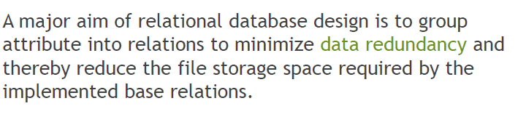
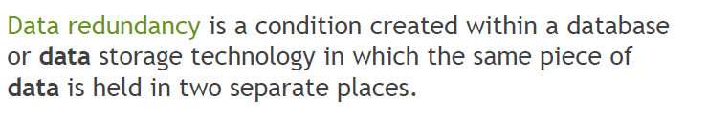
Data Redundancy and Update Anomalies

Slide 10
Normalization
Normalization is a database design technique that reduces data redundancy and eliminates undesirable characteristics like Insertion, Update and Deletion Anomalies.
Types of Normal forms
1. First Normal Form
2. Second Normal Form
3. Third Normal Form
4. BCNF (Boyce Codd Normal Form)
5. Fifth Normal Form

Slide 11
1st Normal Form (1NF)
A table is referred to as being in its First Normal Form if
atomicity of the table is 1.
Here, atomicity states that a single cell cannot hold multiple
values. It must hold only a single-valued attribute.
The First normal form disallows the multi-valued attribute, composite attribute, and their combinations.
Let’s understand the First Normal Form with the help of an example.

Slide 12
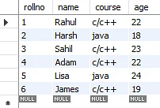
Below is a students’ record table that has information about student roll number, student name, student course, and age of the student.
In the students record table, you can see that the course column has two values. Thus it does not follow the First Normal Form.

Slide 13
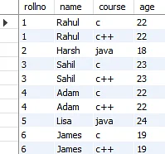
Now, if you use the First Normal Form to the previous table, you get the below table as a result.
By applying the First Normal Form, you achieve atomicity, and also every column has unique values.

Slide 14
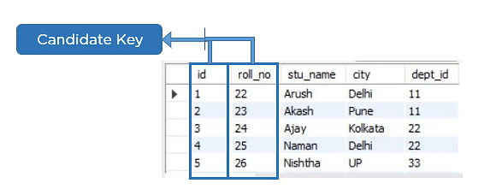
Before proceeding with the Second Normal Form, get familiar with Candidate Key and Super Key.
Candidate Key
A candidate key is a set of one or more columns that can identify a record uniquely in a table, and you can use each candidate key as a Primary Key.
Now, let’s use an example to understand this better.

Slide 15
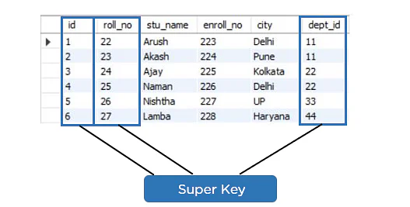
Super Key
Super key is a set of over one key that can identify a record uniquely in a table, and the Primary Key is a subset of Super Key.
Let’s understand this with the help of an example.

Slide 16
Second Normal Form (2NF)
In the 2NF, relational must be in 1NF.
In the second normal form, all non-key attributes are fully functional dependent on the primary key
Example: Let's assume, a school can store the data of teachers and the subjects they teach. In a school, a teacher can teach more than one subject.

Slide 17
TEACHER table
TEACHER_ID | SUBJECT | TEACHER_AGE
25 | Chemistry | 30
25 | Biology | 30
47 | English | 35
83 | Math | 38
83 | Computer | 38
In the given table, non-prime attribute TEACHER_AGE is dependent on TEACHER_ID which is a proper subset of a candidate key. That's why it violates the rule for 2NF.
To convert the given table into 2NF, we decompose it into two tables:

Slide 18
TEACHER_DETAIL table:
TEACHER_ID | TEACHER_AGE
25 | 30
47 | 35
83 | 38
TEACHER_SUBJECT table:
TEACHER_ID | SUBJECT
25 | Chemistry
25 | Biology
47 | English
83 | Math
83 | Computer

Slide 19
Third Normal Form (3NF)
A relation will be in 3NF if it is in 2NF and not contain any transitive partial dependency.
3NF is used to reduce the data duplication. It is also used to achieve the data integrity.
If there is no transitive dependency for non-prime attributes, then the relation must be in third normal form.
A relation is in third normal form if it holds atleast one of the following conditions for every non-trivial function dependency
X → Y.
X is a super key.
Y is a prime attribute, i.e., each element of Y is part of some candidate key.
Example:

Slide 20
EMPLOYEE_DETAIL table:
EMP_ID | EMP_NAME | EMP_ZIP | EMP_STATE | EMP_CITY
222 | Harry | 201010 | UP | Noida
333 | Stephan | 02228 | US | Boston
444 | Lan | 60007 | US | Chicago
555 | Katharine | 06389 | UK | Norwich
666 | John | 462007 | MP | Bhopal
Super key in the table above:
{EMP_ID}, {EMP_ID, EMP_NAME}, {EMP_ID, EMP_NAME, EMP_ZIP}....so on
Candidate key: {EMP_ID}
Non-prime attributes: In the given table, all attributes except EMP_ID are non-prime.
Here, EMP_STATE & EMP_CITY dependent on EMP_ZIP and EMP_ZIP dependent on EMP_ID. The non-prime attributes (EMP_STATE, EMP_CITY) transitively dependent on super key(EMP_ID). It violates the rule of third normal form.
That's why we need to move the EMP_CITY and EMP_STATE to the new <EMPLOYEE_ZIP> table, with EMP_ZIP as a Primary key.

Slide 21
EMPLOYEE table:
EMP_ID | EMP_NAME | EMP_ZIP
222 | Harry | 201010
333 | Stephan | 02228
444 | Lan | 60007
555 | Katharine | 06389
666 | John | 462007
EMPLOYEE_ZIP table:
EMP_ZIP | EMP_STATE | EMP_CITY
201010 | UP | Noida
02228 | US | Boston
60007 | US | Chicago
06389 | UK | Norwich
462007 | MP | Bhopal

Slide 22
Boyce Codd Normal Form (BCNF)
Boyce Codd Normal Form is also known as 3.5 NF. It is the superior version of 3NF and was developed by Raymond F. Boyce and Edgar F. Codd to tackle certain types of anomalies which were not resolved with 3NF.
The first condition for the table to be in Boyce Codd Normal Form is that the table should be in the third normal form. Secondly, every Right-Hand Side (RHS) attribute of the functional dependencies should depend on the super key of that particular table.
For example :
You have a functional dependency X → Y. In the particular functional dependency, X has to be the part of the super key of the provided table.

Slide 23
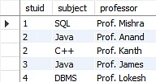
Consider the subject table:
The subject table follows these
conditions:
Each student can enroll in multiple subjects.
Multiple professors can teach a particular subject.
For each subject, it assigns a professor to the student.
In the above table, student_id and subject together form the primary key because using student_id and subject; you can determine all the table columns.
Another important point to be noted here is that one professor teaches only one subject, but one subject may have two professors.
Which exhibit there is a dependency between subject and professor, i.e. subject depends on the professor's name.

Slide 24
This table follows all the Normal forms except the Boyce Codd Normal Form.
As you can see stuid, and subject forms the primary key, which means the subject attribute is a prime attribute.
However, there exists yet another dependency - professor → subject.
BCNF does not follow in the table as a subject is a prime attribute, the professor is a non-prime attribute.
.

Slide 25
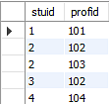
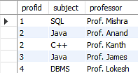
To transform the table into the BCNF, you will divide the table into two parts.
One table will hold stuid which already exists and the second table will hold a newly created column profid and in the second table will have the columns profid, subject, and professor, which satisfies the BCNF

Slide 26
Multivalued Dependency
Multivalued dependency occurs when two attributes in a table are independent of each other but, both depend on a third attribute.
A multivalued dependency consists of at least two attributes that are dependent on a third attribute that's why it always requires at least three attributes.
Example: Suppose there is a bike manufacturer company which produces two colors(white and black) of each model every year.
BIKE_MODEL | MANUF_YEAR | COLOR
M2011 | 2008 | White
M2001 | 2008 | Black
M3001 | 2013 | White
M3001 | 2013 | Black
M4006 | 2017 | White
M4006 | 2017 | Black

Slide 27
Here columns COLOR and MANUF_YEAR are dependent on BIKE_MODEL and independent of each other.
In this case, these two columns can be called as multivalued dependent on BIKE_MODEL.
The representation of these dependencies is shown below:
BIKE_MODEL → → MANUF_YEAR
BIKE_MODEL → → COLOR
This can be read as "BIKE_MODEL multidetermined MANUF_YEAR" and "BIKE_MODEL multidetermined COLOR".

Slide 28

Fourth normal form (4NF)
A relation will be in 4NF if it is in Boyce Codd normal form and has no multi-valued dependency.
For a dependency A → B, if for a single value of A, multiple values of B exists, then the relation will be a multi-valued dependency.
Example:

Slide 29
The given STUDENT table is in 3NF, but the COURSE and HOBBY are two independent entity. Hence, there is no relationship between COURSE and HOBBY.
In the STUDENT relation, a student with STU_ID, 21 contains two courses, Computer and Math and two hobbies, Dancing and Singing. So there is a Multi-valued dependency on STU_ID, which leads to unnecessary repetition of data.

Slide 30


So to make the above table into 4NF, we can decompose it into two tables:

Slide 31
Relational Decomposition
When a relation in the relational model is not in appropriate normal form then the decomposition of a relation is required.
In a database, it breaks the table into multiple tables.
If the relation has no proper decomposition, then it may lead to problems like loss of information.
Decomposition is used to eliminate some of the problems of bad design like anomalies, inconsistencies, and redundancy.
Types of Decomposition
Lossless Decomposition
Dependency Preserving

Slide 32
Lossless Decomposition
If the information is not lost from the relation that is decomposed, then the decomposition will be lossless.
The lossless decomposition guarantees that the join of relations will result in the same relation as it was decomposed.
The relation is said to be lossless decomposition if natural joins of all the decomposition give the original relation.
Example:
EMPLOYEE_DEPARTMENT table:
EMP_ID | EMP_NAME | EMP_AGE | EMP_CITY | DEPT_ID | DEPT_NAME
22 | Denim | 28 | Mumbai | 827 | Sales
33 | Alina | 25 | Delhi | 438 | Marketing
46 | Stephan | 30 | Bangalore | 869 | Finance
52 | Katherine | 36 | Mumbai | 575 | Production
60 | Jack | 40 | Noida | 678 | Testing
The above relation is decomposed into two relations EMPLOYEE and DEPARTMENT

Slide 33
EMPLOYEE table:
EMP_ID | EMP_NAME | EMP_AGE | EMP_CITY
22 | Denim | 28 | Mumbai
33 | Alina | 25 | Delhi
46 | Stephan | 30 | Bangalore
52 | Katherine | 36 | Mumbai
60 | Jack | 40 | Noida
DEPARTMENT table
DEPT_ID | EMP_ID | DEPT_NAME
827 | 22 | Sales
438 | 33 | Marketing
869 | 46 | Finance
575 | 52 | Production
678 | 60 | Testing

Slide 34
Now, when these two relations are joined on the common column "EMP_ID", then the resultant relation will look like:
Employee ⋈ Department
EMP_ID | EMP_NAME | EMP_AGE | EMP_CITY | DEPT_ID | DEPT_NAME
22 | Denim | 28 | Mumbai | 827 | Sales
33 | Alina | 25 | Delhi | 438 | Marketing
46 | Stephan | 30 | Bangalore | 869 | Finance
52 | Katherine | 36 | Mumbai | 575 | Production
60 | Jack | 40 | Noida | 678 | Testing
Hence, the decomposition is Lossless join decomposition.

Slide 35
Dependency Preserving
It is an important constraint of the database.
In the dependency preservation, at least one decomposed table must satisfy every dependency.
If a relation R is decomposed into relation R1 and R2, then the dependencies of R either must be a part of R1 or R2 or must be derivable from the combination of functional dependencies of R1 and R2.
For example, suppose there is a relation R (A, B, C, D) with functional dependency set (A->BC). The relational R is decomposed into R1(ABC) and R2(AD) which is dependency preserving because FD A->BC is a part of relation R1(ABC).

Slide 36

Fifth normal form (5NF)
A relation is in 5NF if it is in 4NF and not contains any join dependency and joining should be lossless.
5NF is satisfied when all the tables are broken into as many tables as possible in order to avoid redundancy.
5NF is also known as Project-join normal form (PJ/NF).

Slide 37
In the above table, John takes both Computer and Math class for Semester 1 but he doesn't take Math class for Semester 2.
In this case, combination of all these fields required to identify a valid data.
Suppose we add a new Semester as Semester 3 but do not know about the subject and who will be taking that subject so we leave Lecturer and Subject as NULL. But all three columns together acts as a primary key, so we can't leave other two columns blank.
So to make the above table into 5NF, we can decompose it into three relations P1, P2 & P3:

Slide 38


P1

Slide 39
Summary
Normal Form | Description
1NF | A relation is in 1NF if it contains an atomic value.
2NF | A relation will be in 2NF if it is in 1NF and all non-key attributes are fully functional dependent on the primary key.
3NF | A relation will be in 3NF if it is in 2NF and no transition dependency exists.
BCNF | A stronger definition of 3NF is known as Boyce Codd's normal form.
4NF | A relation will be in 4NF if it is in Boyce Codd's normal form and has no multi-valued dependency.
5NF | A relation is in 5NF. If it is in 4NF and does not contain any join dependency, joining should be lossless.

